Slide 1
SAS@BAUS
Beginning to Now
&
GIRFT for CESR
Nitin Shrotri
@PeaPeaspot

Slide 2
Background
Personal story
Professional experience
BMA blog: “Rising up the ranks” & BMA Role
More at nitinshrotri.com

Slide 3
My GIRFT application presentation 2019

Slide 4
Project SAS@BAUS
Reasons & Aim:
As a result of Seen & Lived experiences
For SAS and Locally Employed Doctors
Doctors from international backgrounds
Stumbling around in an unfamiliar system
Brand new project supporting the last “Lost tribe”
Offer a sense of belonging, & integration in society
Exciting new prospects for doctors in the SAS grade

Slide 5
Project SAS@BAUS
Choice, Benefit, Effect
Choice of:
Work at your own chosen level of responsibility or
Simply learn a new skill or
Become Consultant via CESR route should you choose to
Benefits as desired:
Receive Mentoring, or be a Mentor – satisfying
Benefits Individual, Specialty & NHS
Offers opportunity according to level of skill
Wider effects:
Decreases discrimination
Promotes equality of opportunity

Slide 6
Project SAS@BAUS
First year: 2020-21
Started as informal mentoring
Supported superbly by Tim O’Brien, BAUS President
Recognized the gaps that needed addressing
20 Mentors & 20 Mentees
3 Webinars arranged on various topics plus Zoom meetings
Led to 1st ever SAS Session at BAUS Annual conference in June, BAUS 2021
Speakers were:
Megan Reitz, on “Speaking Up and Listening – Pussycats & Tigers”
Paul Deemer, NHS Employers – “Getting across brick walls”
Tim Terry on “Mentoring”

Slide 7
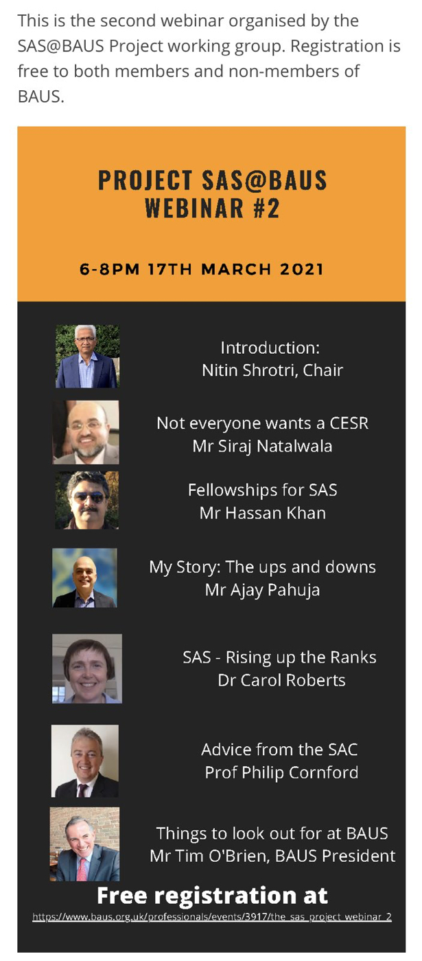
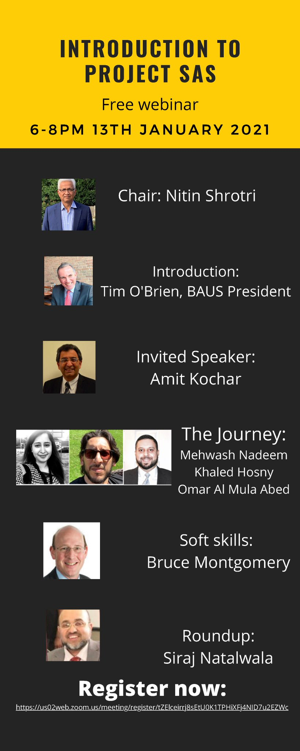
Webinars 2020-21

Slide 8
What went well
Support/Publicity from Tim and BAUS, & website information
Raised awareness of a large group, previously under-recognised
Hard work, without expectation, from mentors
Gratitude from mentees
Enthusiasm from other colleagues
Landmark first SAS session at BAUS
Improved awareness amongst other bodies
Perhaps, a pilot for other specialities

Slide 9
What could have gone better
Expectations very fluid, not set out or crystalized
BAUS membership
Inadequate awareness in departments
CESR focused, needs broadening & use of Forum
Establishing an Education session for mentors
Funding/Inclusion in job planning
Lack of F2F meetings
Hit & miss communication between Mentors & Mentees

Slide 10
What we need
Continued support from all
Mentors
Mentees
Contract
Ensure Feedback
Comms with Clinical Leads
TSOB and Jo Cresswell BAUS President and VP
Beverly Tomkins & BAUS Admin

Slide 11
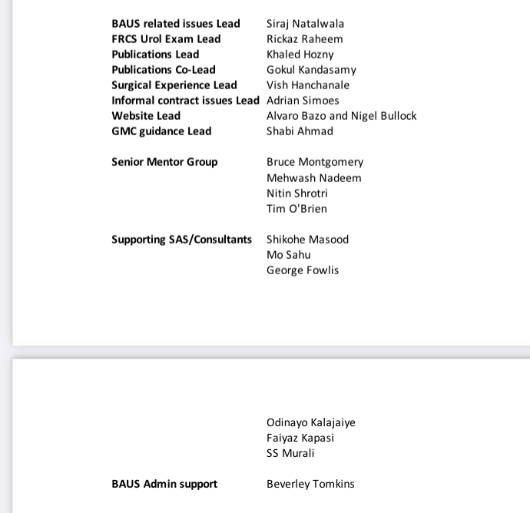
Plans for 21-22 guiding 30 mentees
Semi-formal contract set up
Leads for activities-interaction
BAUS membership
Regular meetings calendar: Training vs CESR, FRCS Urol, Research, Info on Sponsorship schemes
Feedback forms
Presentation of results at BAUS 22
Group photo Class of 21-22

Slide 12
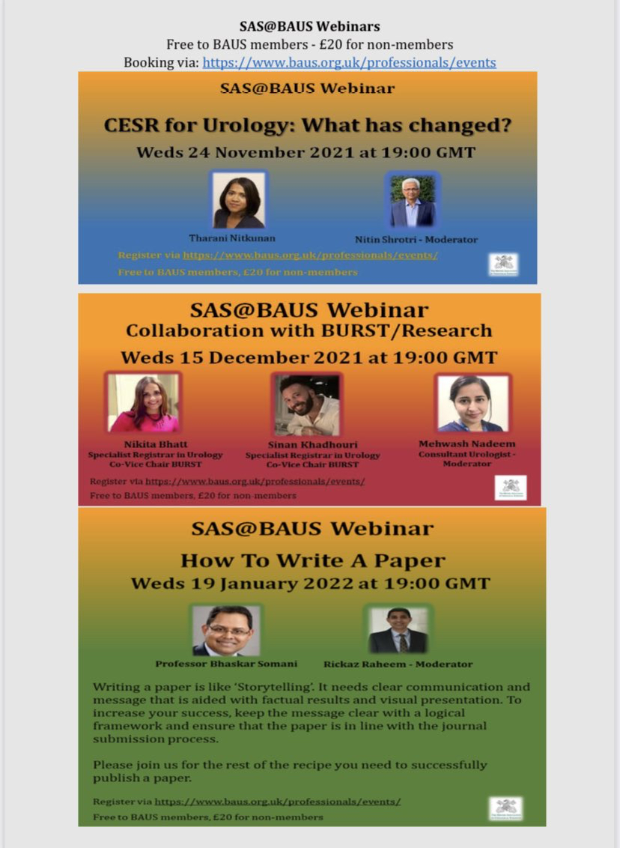
SAS@BAUS
Monthly webinars
Nov 21-April 22
An instructive webinar on the 3rd Wednesday of every month on a topic of relevance has been arranged.
The first 3 are:
CESR for Urology: What has changed
Collaboration with BURST/Research
How to write a paper

Slide 13
SAS@BAUS
Monthly webinars
The other 3 are:
GMC aspects of the CESR process
Managing Complaints
Education: Surgical Colleges and SAS doctors

Slide 14
Future plans:
Act as a Pilot for other specialities
GIRFT for CESR: Pilot project for Urology with the GMC, 1st meeting held on 28/1/22
Formalize BMA support for this project
Interest shown by HEKSS and SAS Vascular Surgeons
Invite from HEESW to speak at the CESR Conference in May
Further engagement with WRES

Slide 15
GIRFT FOR CESR : 22/11/2021
Aim:
GIRFT: highly commended national project with Leads in every speciality.
Urology pass rate for CESR has decreased from 70% to 48% to 40% over the last three 5-year periods.
Use GIRFT principles to improve the pathway by getting together a small group of interested/relevant individuals to take it forward as a pilot project.
Plan:
Start a Urology pilot
SAS@BAUS Project already in place
Work together with Urology GIRFT Lead, SAC Lead & IBUS Lead

Slide 16
Recap:
Do as much as one wants:
-Continue, Particular skill, Autonomous practice, Consultant
A pilot for every speciality
All bodies are coming on board:
GMC, RCS, HEE, WRES, GIRFT
National interest due to:
-Covid crisis and genuine push for EDI

Slide 17
Main achievement: Raised profile, value and importance of SAS/LEDs
Thank you
@PeaPeaspot
nitinshrotri.com

